Slide 1

An Introduction to calculus
(MAT 1031)
Syllabus and Marks Assessment Policy
Dr. Sheerin Kayenat
Assistant Professor (Grade I)
SASL – Mathematics,
VIT Bhopal University.

Slide 2
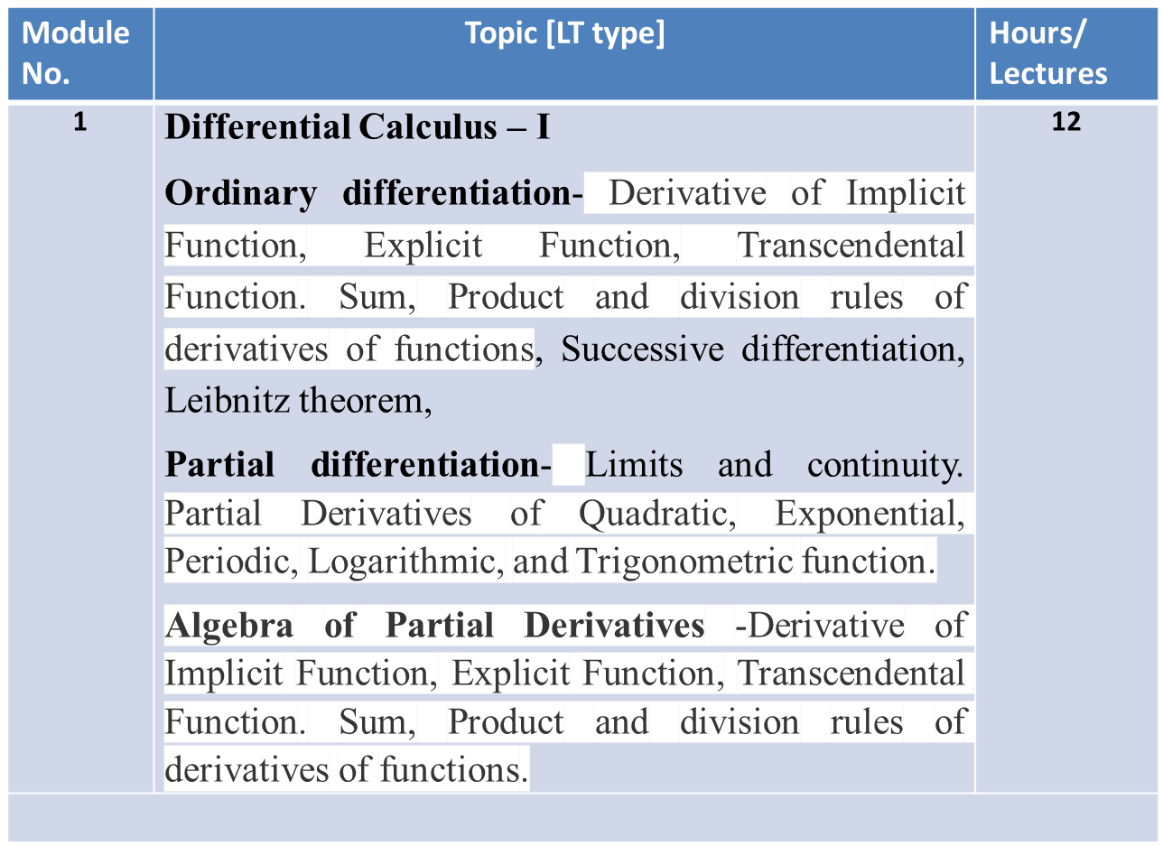
Syllabus

Slide 3
Module No. | Topic [LT type] | Hours/ Lectures
2 | Differential Calculus – II Euler’s Theorem, Derivatives by Chain rule. Maxima and minima of functions of several variables by Lagrange's method of multipliers (Simple applications). Expansion of function of several variables Taylor’s and Maclaurin’s theorem on one and two variables. Approximation of errors. | 12

Slide 4
Conti…
Module No. | Topic | Hours/ Lectures
3 | Integral Calculus - I Methods of integration – Definite integrals and its properties. Double integration in Cartesian and polar coordinates – Change of order of integration – Area enclosed by plane curves. | 12
4 | Integral Calculus – II Double integrals over rectangles and general regions. Change of variables in double integrals - Area of a curved surface - Triple integration in Cartesian coordinates. Volume of Solids. | 12

Slide 5
Conti…
Module No. | Topic | Hours/ Lectures
5 | Matrices Introduction, Elementary row and column transformations, Rank of matrix, Linear dependence, Consistency of linear system of equations, characteristic equation, Eigen values and Eigen vectors, Mathematical modelling of some simple biological system. | 10

Slide 6
Continuous and Final Assessment Policy
Sr. No. | Component | Marks allotted | Weightage
1 | Mid Term Exam | 50 | 60%
2 | TEE | 100 | 30%
TOTAL |  | 150 | 40%

Slide 7
Internal Assessment Policy LT Type
Sr. No. | Component | No. of Attempts | Marks allotted each attempt | Policy | Total
1 | Tutorial | 5 | 10 | Average | 10
2 | Quiz | 4 | 10 | Average of best 3 | 10
3 | Assignment | 2 | 05 | Sum | 10
4 | Activity | 2 | 05 | Average | 05
Total marks |  |  |  |  | 35
• 5 marks for attendance

